Slide 1
SMART
BUILDING
Peddi Sakila
Veerannagari Akshita
Gande Varshini

Slide 2
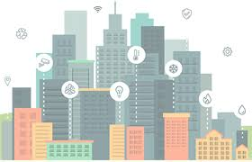
Smart building- The future of your building
A smart building is any structure that uses automated processes to automatically control the building’s operations including heating, ventilation, air conditioning, lighting, security and other systems.
A smart building uses sensors, actuators and microchips, in order to collect data and manage it according to a business’ functions and services.

Slide 3
Problem statement
Reducing electrical energy consumption is of paramount importance. One unit of energy saved is equal to one unit of energy generated. Apart from reduction in electricity bills this has a great environmental impact in reducing pollution causing gaseous and liquid pollutants. In this project energy saving system by using Green building concept is brought out.
The model demonstrates the energy consumption in Conventional Building using energy saving parameters such as Temperature, Humidity, lighting controls and some of the measures. The energy saving system consists of three modes i.e., Eco Mode, Away Mode, Manual Mode which turns on/off the electrical appliances when required, all the sensor parameters are sent to the IBM Watson cloud and these values are stored in the database. This data can be visualised in the Node Red UI and through that user interface(UI) the user can control the appliances. Necessary notifications are sent whenever required.

Slide 4
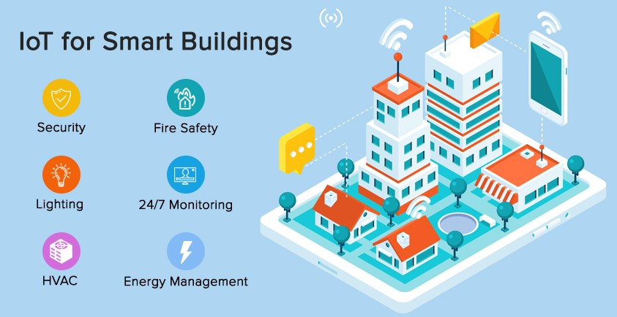

Slide 5
Architecture of smart building

Slide 6
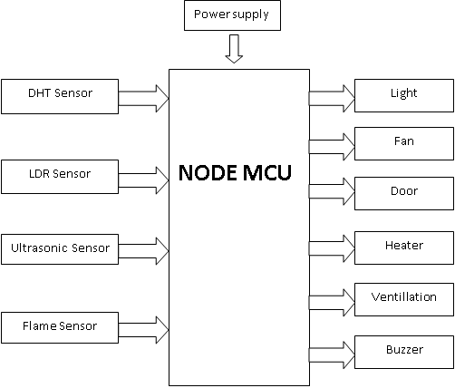
Block diagram of smart building

Slide 7
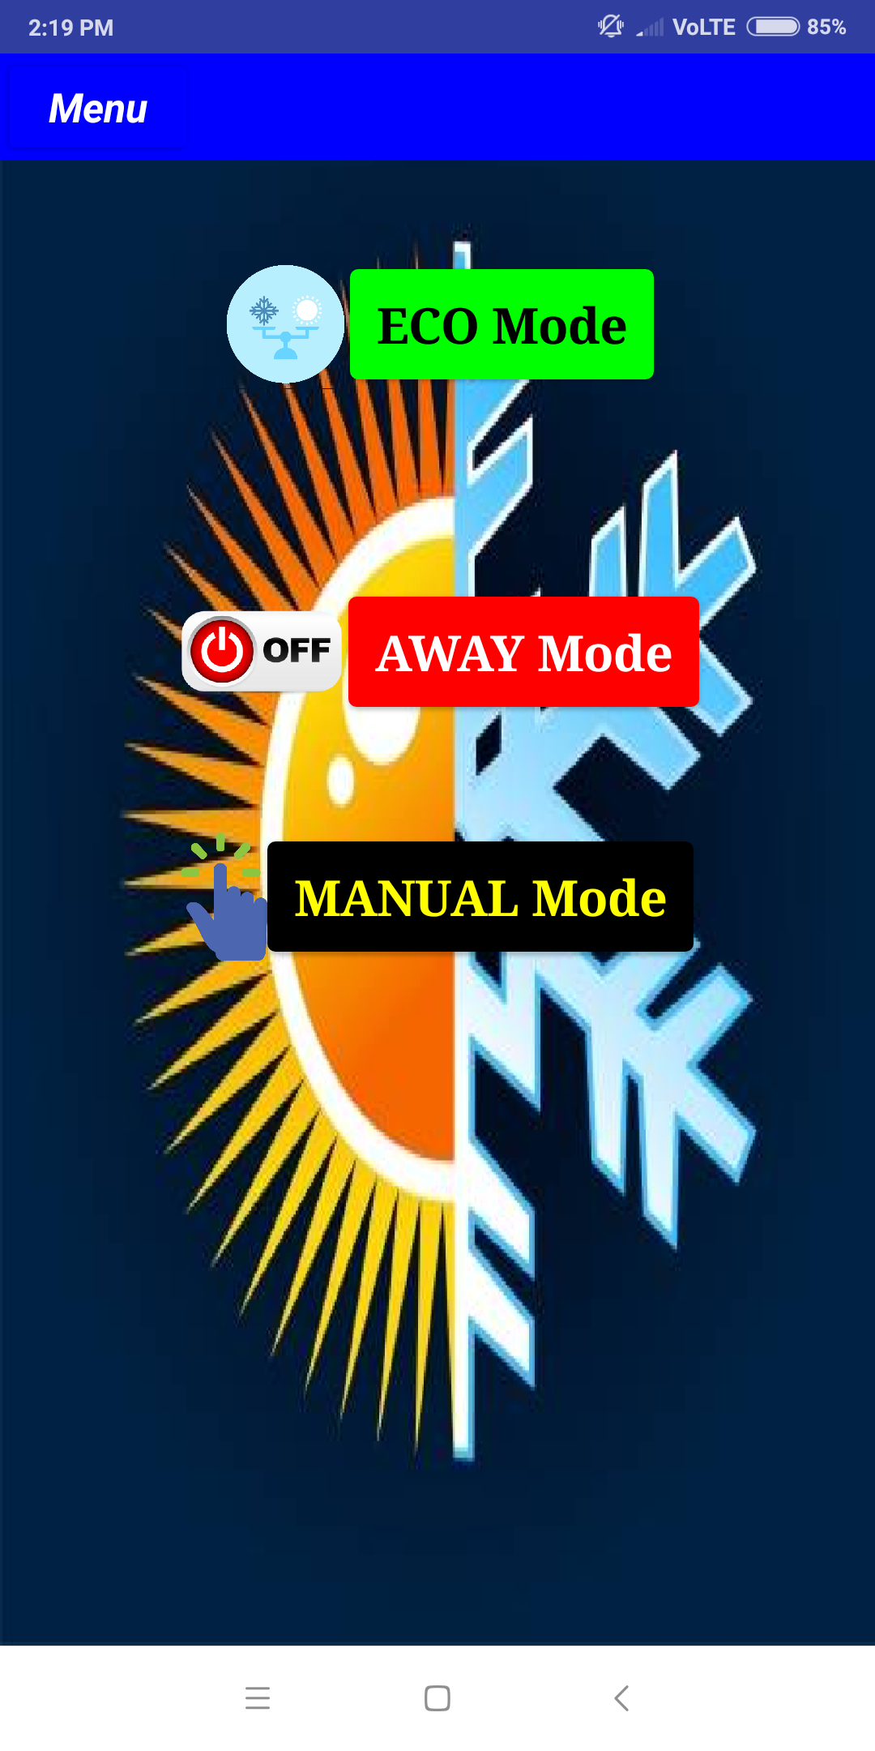
UI MODES
ECO Mode:
Optimal
Away Mode:
Off all appliances
Manual Mode:
Set appliance usage manually

Slide 8
COMPONENTS USED IN THE PROJECT

Slide 9
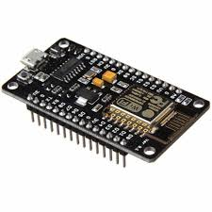
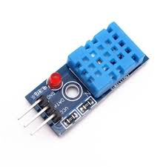
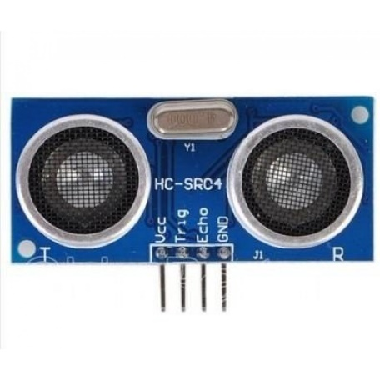

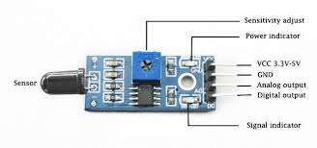
Node MCU
DHT -11
Ultrasonic sensor
Flame Sensor
LDR

Slide 10
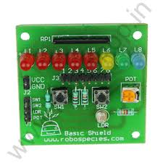
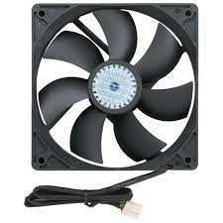
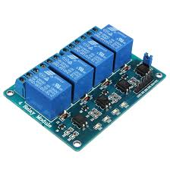
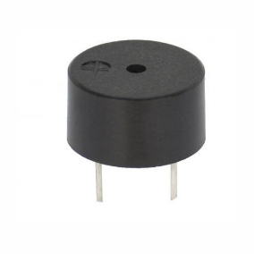
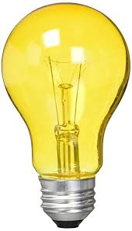
Basic Shield
CPU Fan
Relay setup
Buzzer
Bulb

Slide 11
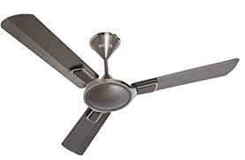


DHT SENSOR

Slide 12
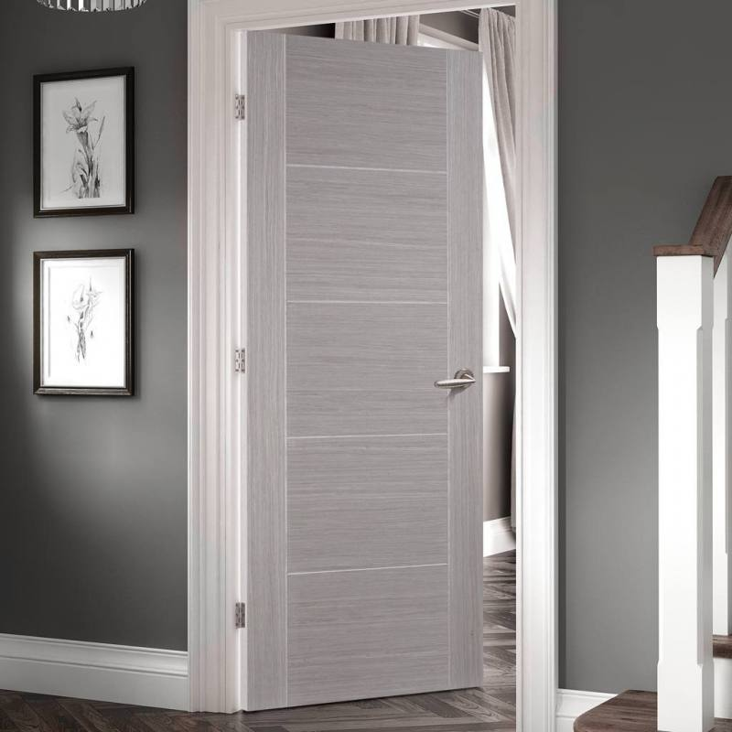
Ultrasonic SENSOR

Slide 13

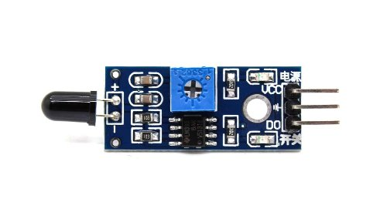
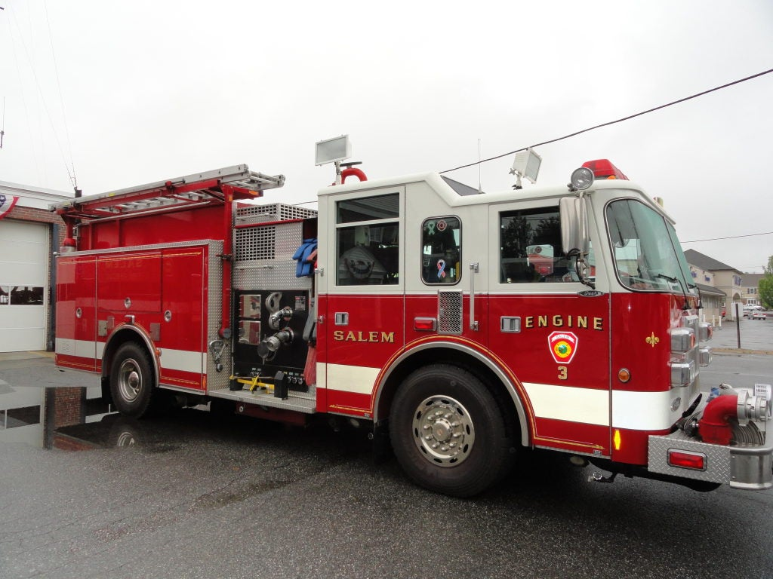
FIRE SENSOR

Slide 14
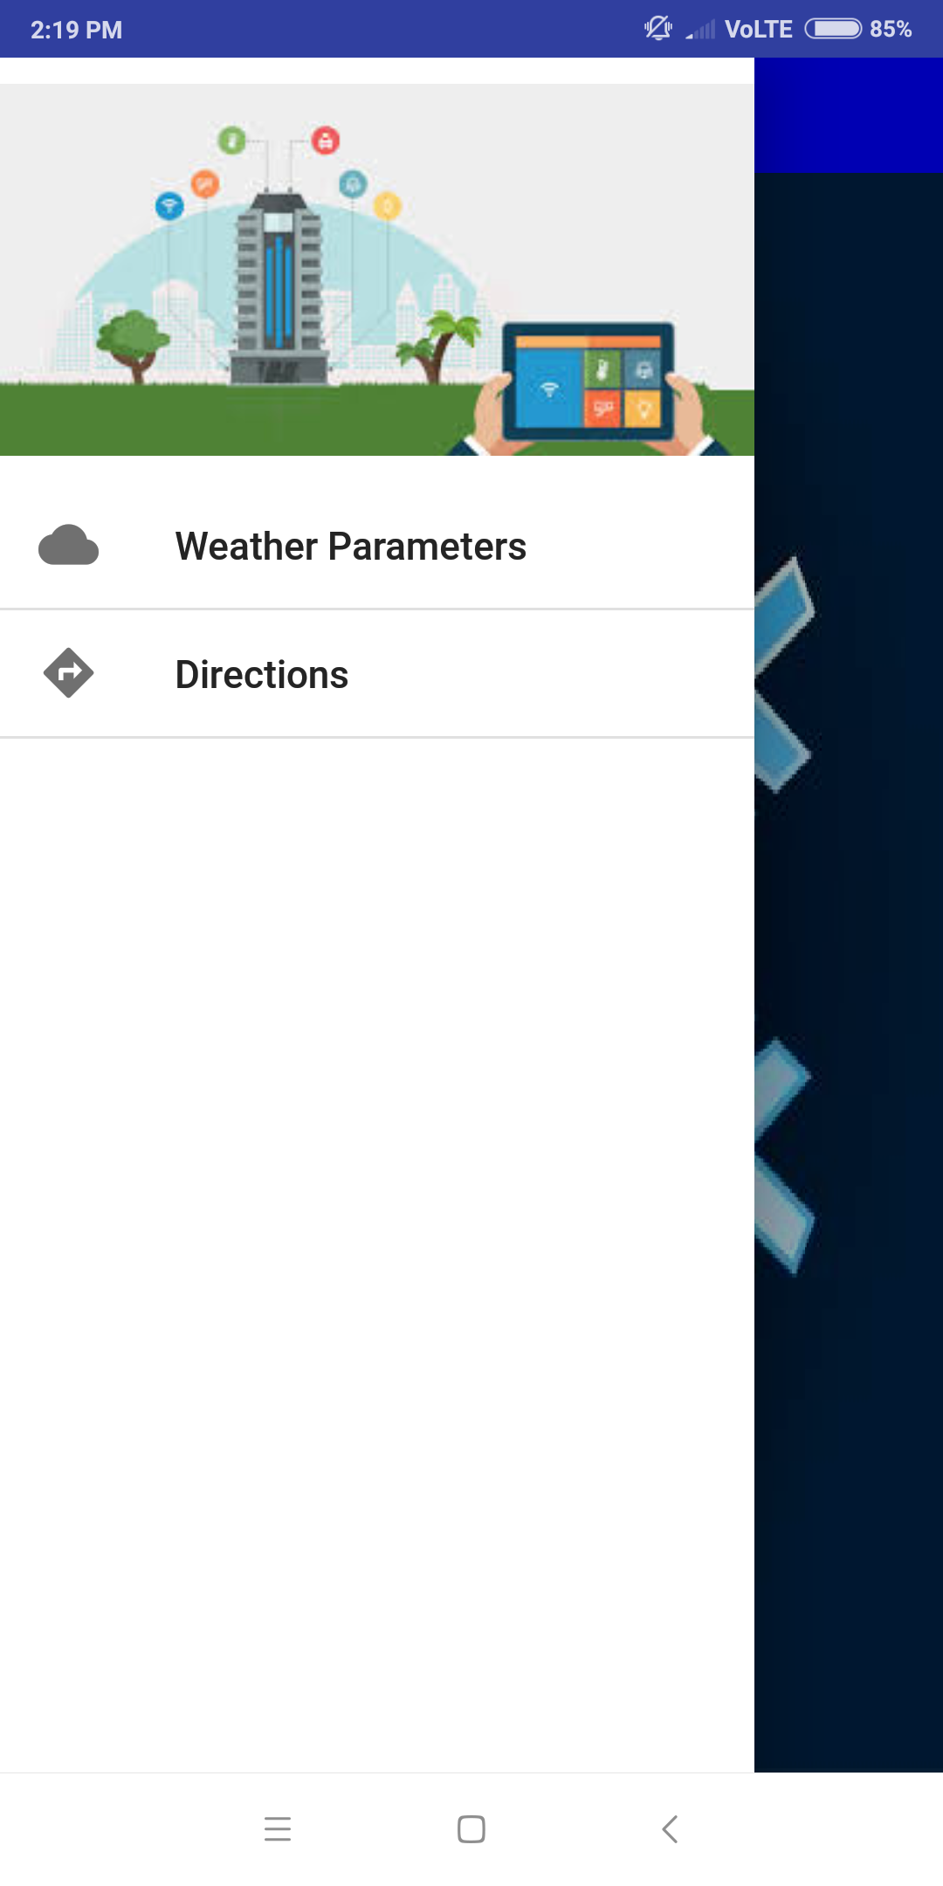
This is the side menu which consists of :
weather parameters
directions

Slide 15
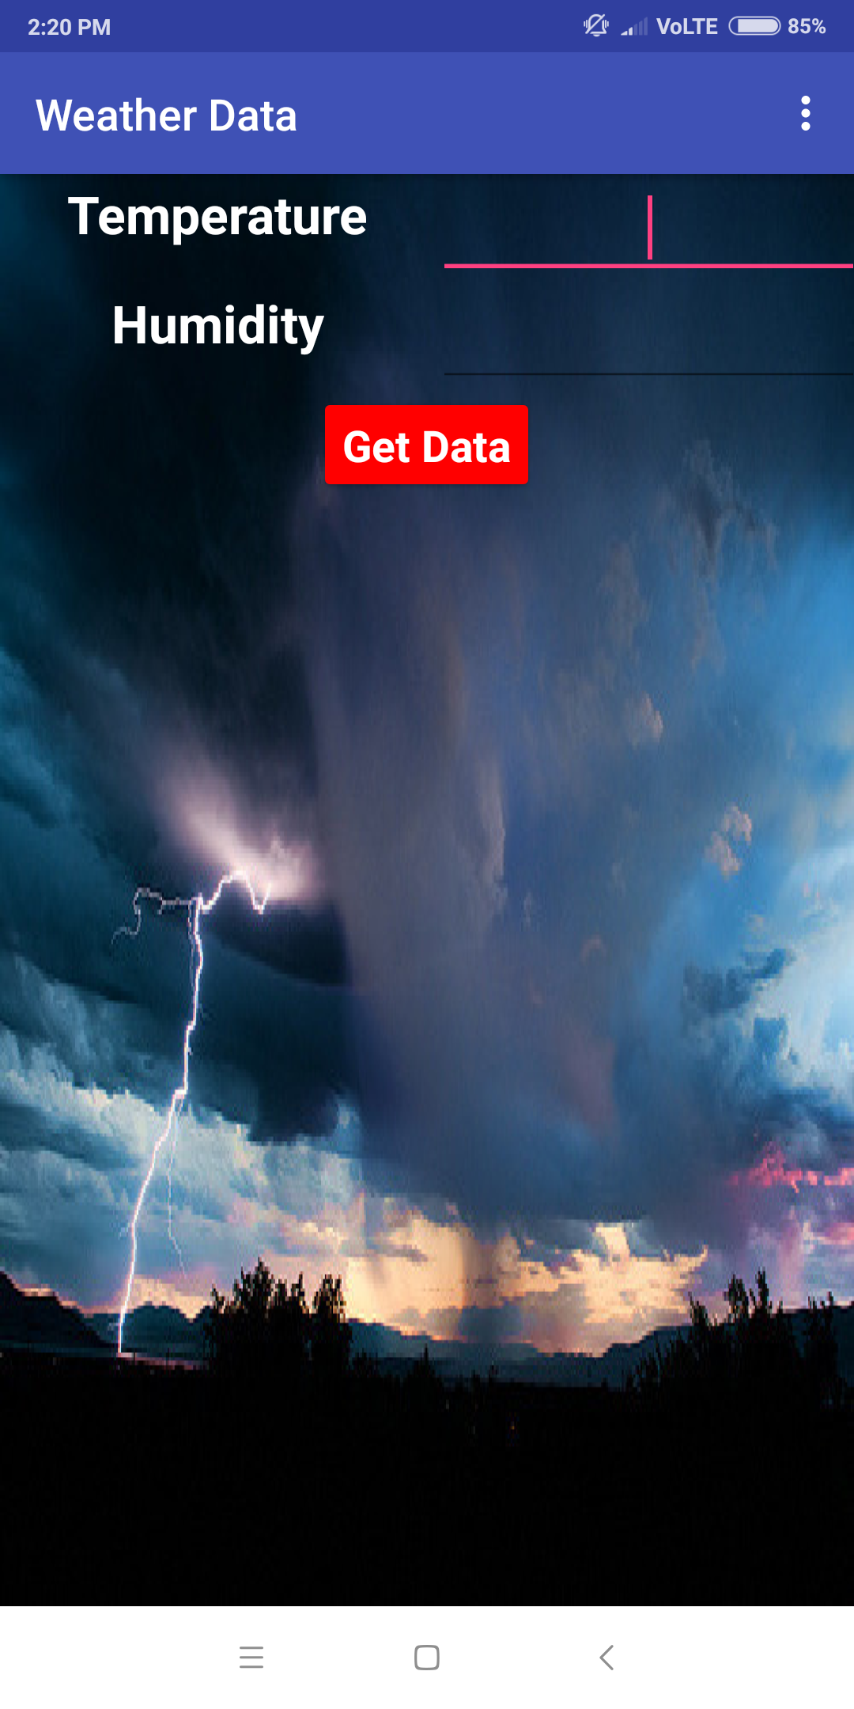
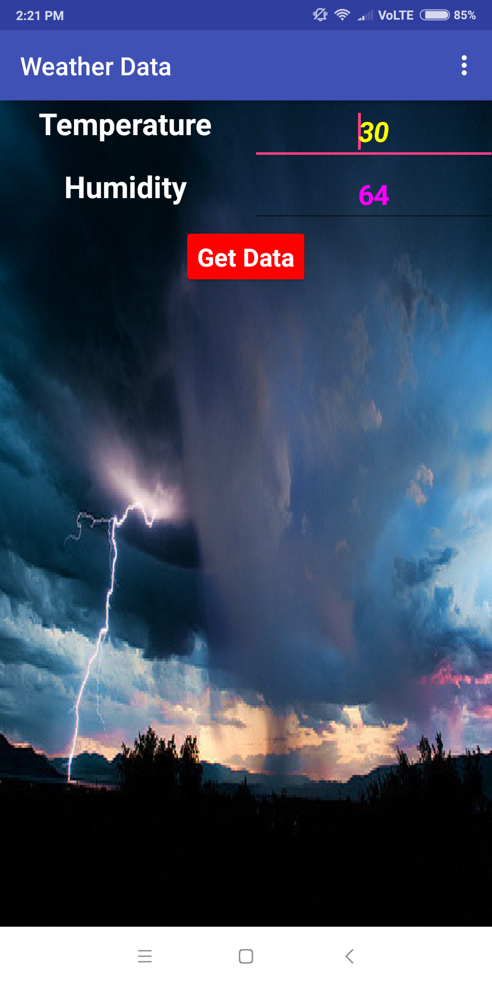
This is weather data screen where in temperature and humidity values from cloud are obtained.

Slide 16
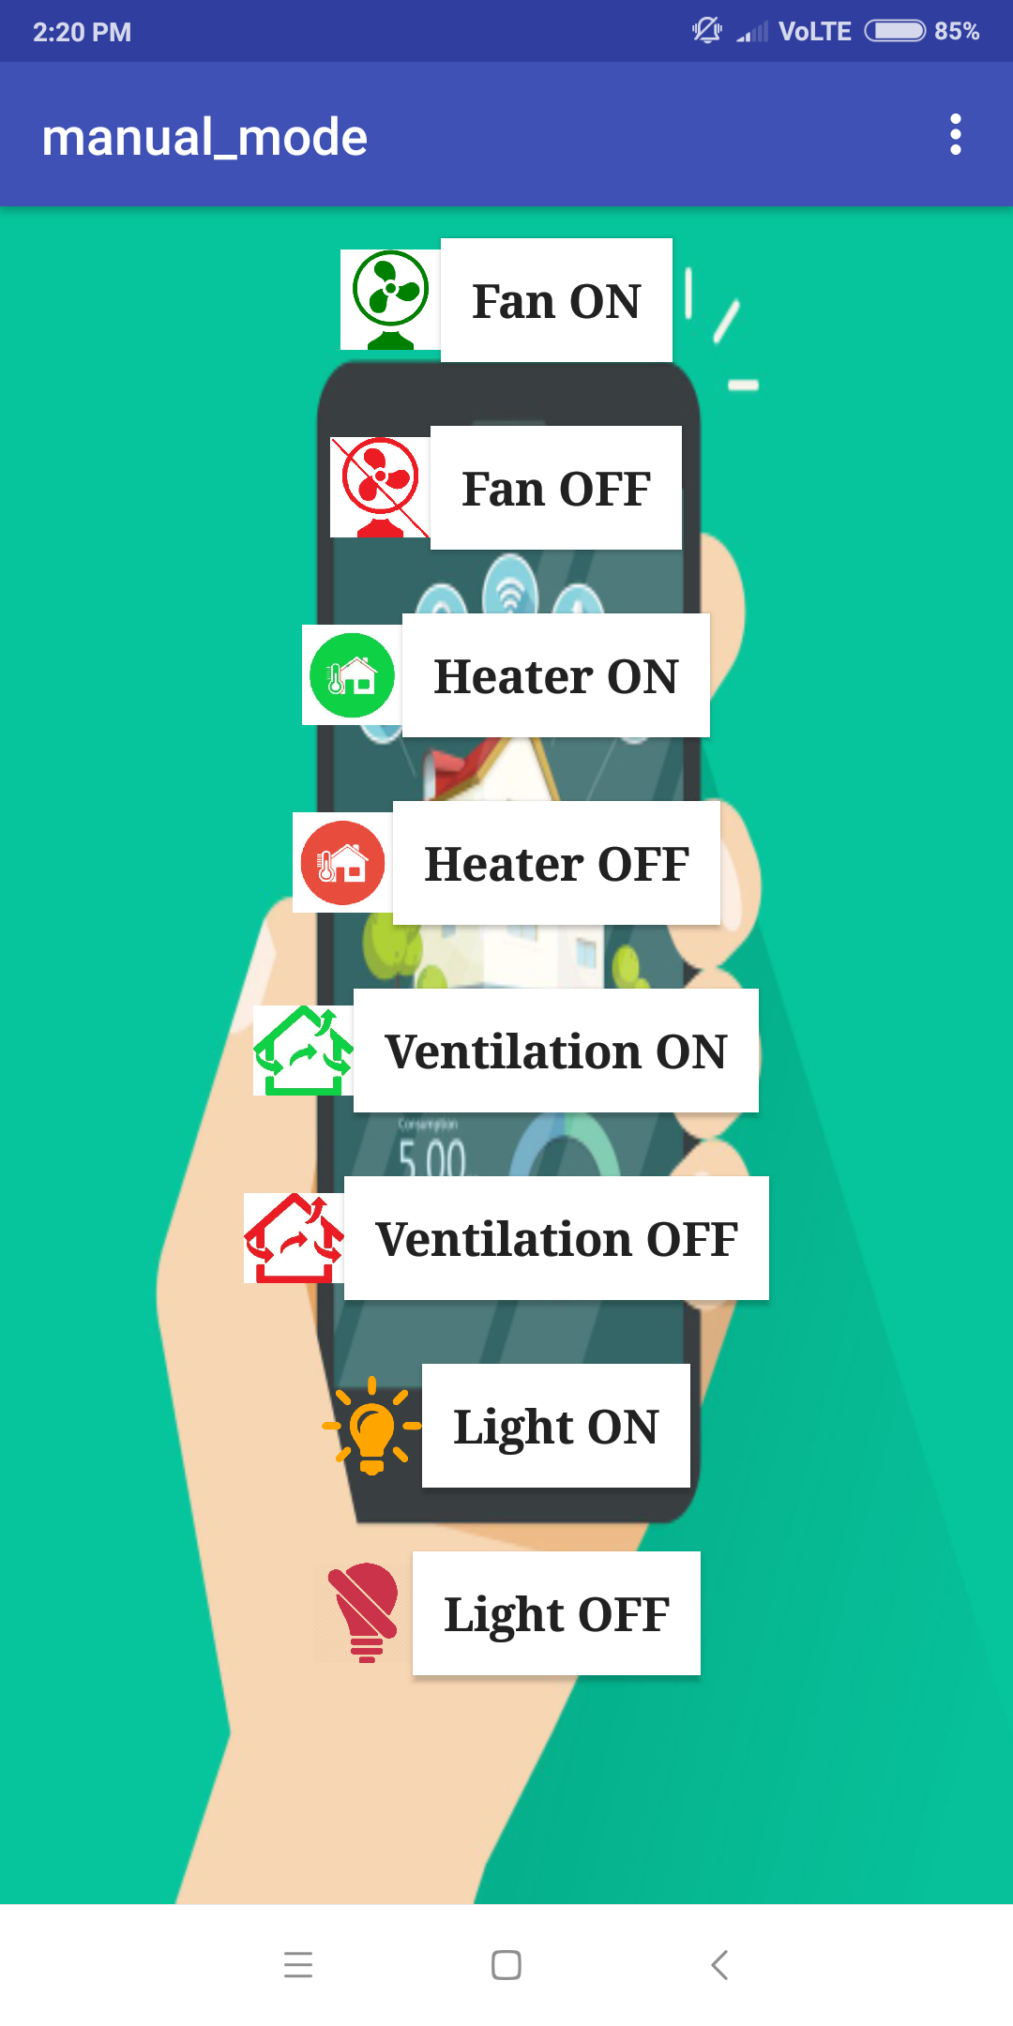
This screen will be appeared by pressing on the manual_mode button .

Slide 17
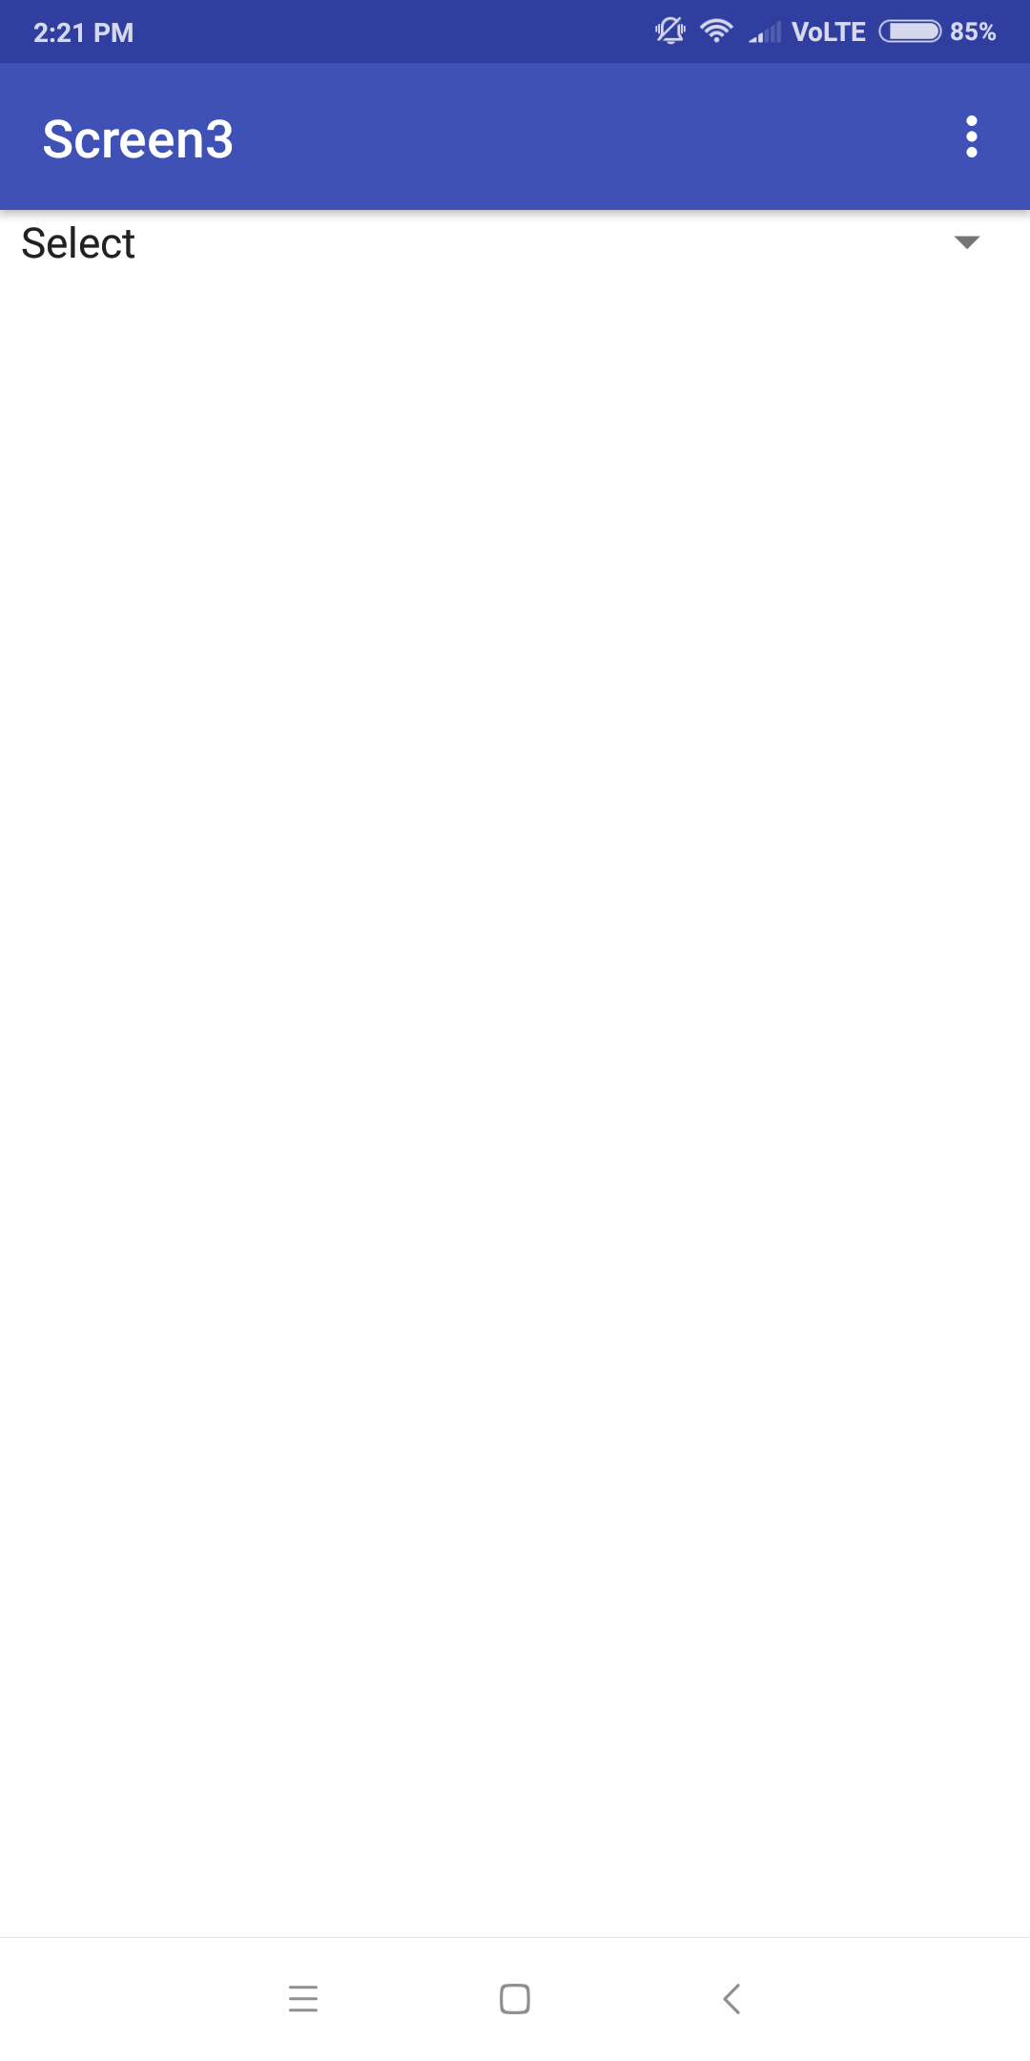
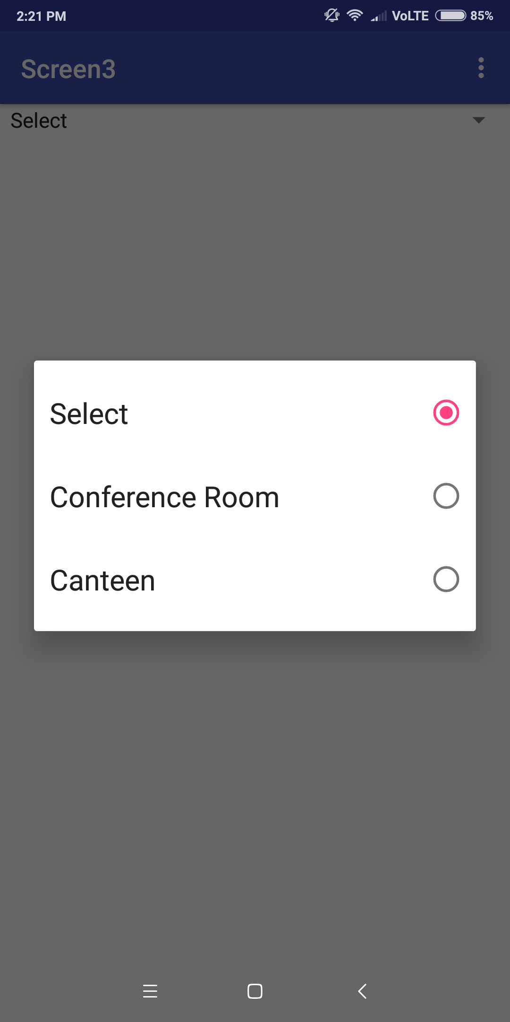
This screen is used for indoor navigation

Slide 18
Necessity
Reducing electrical energy consumption is of paramount importance.
One unit of energy saved is equal to one unit of energy generated.
Apart from reduction in electricity bills this has a great environmental impact in reducing pollution causing gaseous and liquid pollutants.
In this project energy saving system by using Green building concept is brought out.

Slide 19


